Slide 1
Embodied AI week 5
Shaoqin Li

Slide 2
Exploring Loco-mujoco
An open-source imitation learning benchmark created specifically for complex whole-body locomotion tasks (walking, running, squatting, dancing, etc.)
Using MuJoCo (and especially its fast JAX-accelerated version called MJX).
Easy for researchers to train policies (via imitation or RL+imitation) that make robots mimic human or animal motion-capture data in physically-realistic simulation.
https://github.com/robfiras/loco-mujoco
It act as a great platform that has many resources to create your own project

Slide 3
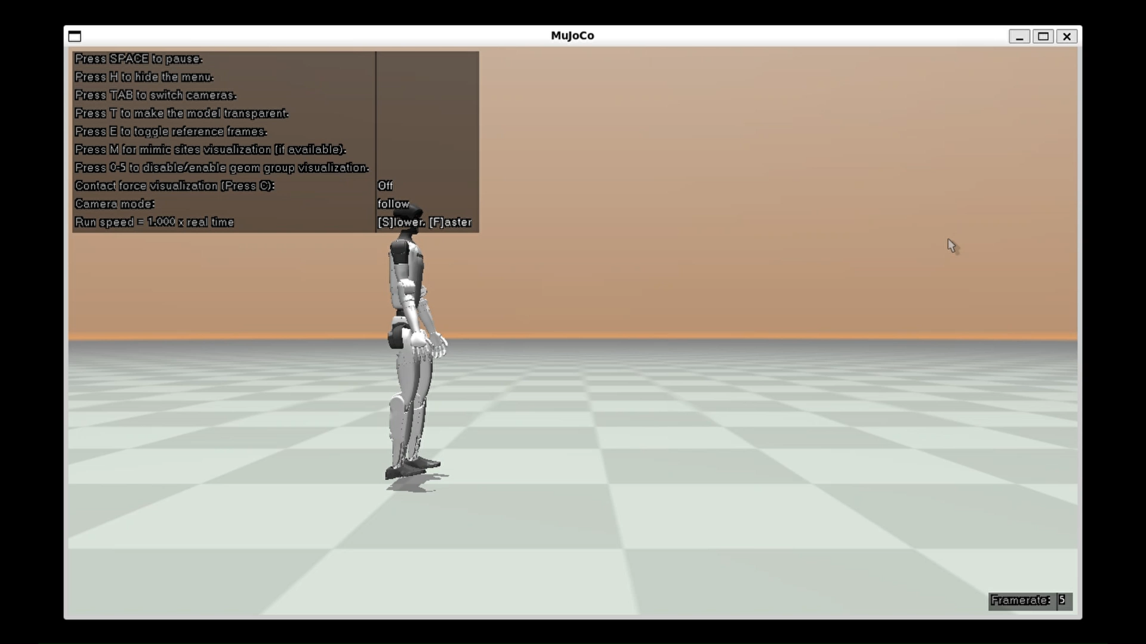
Training Project Example

Slide 4
Script Explain
This project is done by PPO with dense reward that measures how closely the policy tracks reference motions. This project consists of two files: Config.yaml for loading environment configurations and experiment.py for setting up environment and apply rl + il training.

Slide 5
PPO
PPO is a reliable reinforcement learning algorithms to learn complex continuous control skills
Belongs to policy gradient methods (taking small gradient steps to push the NN(policy) toward actions that lead t higher long term reward given the current state s)
The idea is that PPO will clip how much the new policy is allowed to differ from the old one.

Slide 6
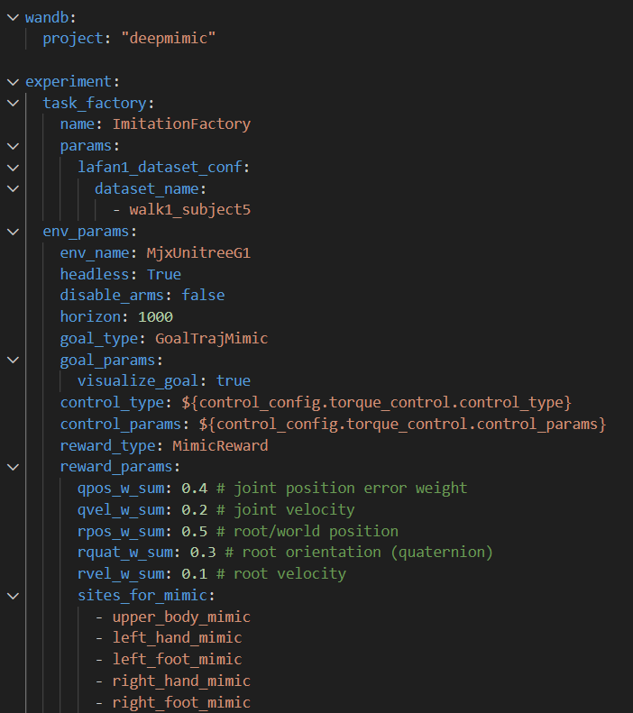
Config
Loads the reference motion from the provided dataset
The MimicReward computes a dense reward at every timestep
It adds up several tracking error terms so that small errors give reward close to 1, large errors give reward close to 0.

Slide 7
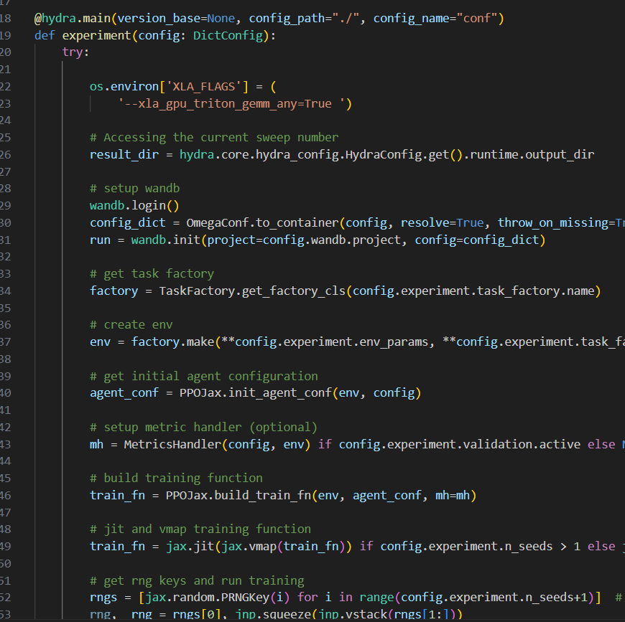
Experiment.py
Act as an “director” of this movie
Setting up all the parameters to the correct setting
Result: Have the video of the trained agent saved

Slide 8
Next: more projects
This platform has a lot of tutorials for setting up different environments
Goal is to add terrains to the current project

